Slide 1
Intro to Data with R
Kang Sun
Yiming Tan
Haoyu Zhang
Xiaoxi Zhao

Slide 2
What is Data Science？
Data Science is the science which uses computer science, statistics and machine learning, visualization and human-computer interactions to collect, clean, integrate, analyze, visualize, interact with data to create data products.

Slide 3

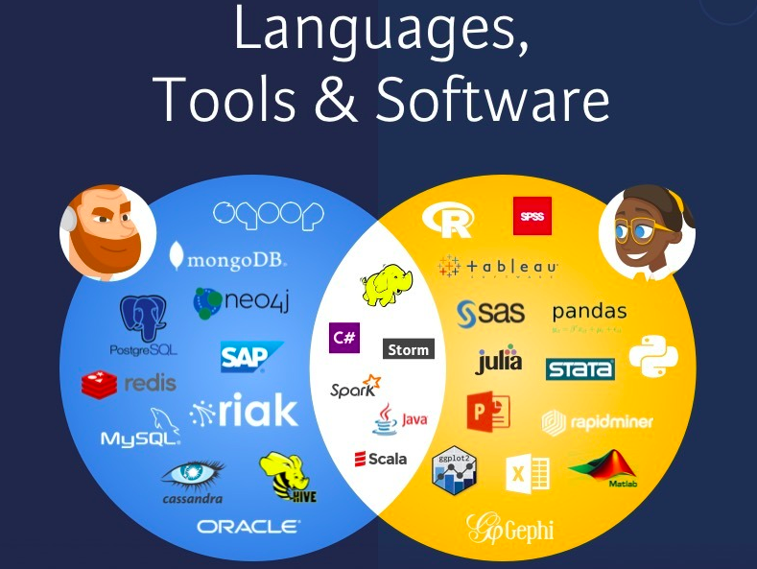

Slide 4


Installing
Rstudio
https://www.rstudio.com/products/rstudio/download/
(Or with) Anaconda
https://docs.anaconda.com/anaconda/install/

Slide 5
How can we get data?
Search open datasets
http://library.columbia.edu
> Location > Business & Economics Library > Business Databases
> Services > Research Data Services > Research Guides / GeoData@Columbia /…
Collect by ourselves
Web scraping (upcoming data club events!)
Go to (Wei’s) Consultation Hours!!!
https://library.columbia.edu/services/research-data-services/schedule.html

Slide 6
Data formats and methods to import
Read data into a vector or list from the console or file
scan()
Spreadsheet-like data
read.table()
read.csv()
Other statistical systems (‘foreign’ package)
SAS Transport format (read.xport)
Minitab Portable Worksheet (read.mtp)
Stata .dta files(read.dts)
R interface for Database management(SQL)
‘RMySQL’, ‘ROracle’, ‘RSQLite’
Others
json (‘rjson’)
image(‘bmp’, ’jpeg’, ‘png’, ‘rtiff’, ‘pixmap’)
binary file(‘h5’, ‘RNetCDF’)
For more information:
https://cran.r-project.org/doc/manuals/r-release/R-data.pdf
And check documentations for the packages above

Slide 7
Data Types in (Python and) R
Kang Sun

Slide 8
Why do we need data types?
We have different kinds of data and we do not use the same format to describe all data we see. That’s why we need different data types.
Data types add constraint on data and make them easy to manage.
Different data types: numeric, complex, logical, character…

Slide 9
Numeric data
Integers and Floating-Point Numbers
The range of integers is not just positive numbers, negative numbers are also integers, like -14131313133133131879 and -1.
Floating-Point Numbers are specified with a decimal point.

Slide 10
Data types of Python --- numeric
Integers (int)
In Python 3, there is effectively no limit to how long an integer value can be. Of course, it is constrained by the amount of memory your system has.
>>> X = 1113123123123124124124124123414
>>> print(X)
Floating-Point Numbers (float)
>>> type(4.2)
<class ‘float’>
>>> type(4.0)
<class ‘float’>
>>> .4e7
4000000.0

Slide 11
Data types of Python --- numeric
With numeric data types, we can perform operations on them.
> K = 3
> B = 2.0
> C = K+B
> print(C)
5.0
> print(type(C))
<type ‘float’>
> K = 3.7
> B = 2.0
> C = K*B
> print(C)
7.4
> print(type(C))
<type ‘float’>
One thing is notice is division between integers
Like 9/2

Slide 12
Data types of R --- numeric
Decimal values are called numerics in R. It is the default computational data type.
> X = 10.5
> class(X)
[1] “numeric”
Furthermore, even if we assign an integer to a variable k, it is still being saved as a numeric value.
> K=1
> class[k]
[1] “numeric”
We can also explicitly tell the R to store a number as an integer ( using “L”)
> K = 2L
> class[k]
[1] “integer”

Slide 13
Data types of R --- numeric
With numeric data types, we can perform operations on them.
> K = 3L
> B = 2.0
> C = K+B
> print(C)
5
> print(class(C))
<type ‘numeric’>
> K = 3.7
> B = 2.0
> C = K*B
> print(C)
7.4
> print(class(C))
<type ‘numeric’>
One thing is notice is operations between integers
Like 9L * 2L generates an integer type value.
Like 9L /2L generates a numeric type value.

Slide 14
Logical data
Logical data just has two values, True and False.
It can not store much information, but we can use it to store status of our program.
The same purpose can also be achieved by using integer values 0,1. But such design is not safe since the integer type can have other many values and there is potential risk that the value is changed.
Logical data only does the task it is assigned! And this is why we need it.

Slide 15
Logical data in Python
Logical type is also called Boolean type in Python.
Two values, ‘True’ and ‘False’. Not ‘TRUE’ or ‘true’ !
We can change between True and False
> X=not True
> print(X)
> print(type(X))
> C = not X
> print(C)
Compare two Boolean data
> X = True
> B = True / B = False
> print(X == B)

Slide 16
Logical data in Python
Comparison operators
> x=2
> 1< x <3
> 10 < x < 20
> x == 3
> x != 2
AND /OR
X and Y = True only when X,Y are True
X or Y = False only when X,Y are False
X and Y can also written as X & Y
X or Y can also written as X or Y
The comparison operators are very important to decide whether we have met the goal.
Assume we want to have run 10 miles, and we use X to store how many miles we have finished.
When X >= 10, stop.

Slide 17
Logical data in R
Two values, ‘TRUE’ and ‘FALSE’. Not ‘True’ or ‘true’ !
> v = TRUE
> print(class(v))
[1] “logical”
> p = ! TRUE
> print(p)
Compare two Boolean data
> X = TRUE
> B = FALSE
> print(X == B)

Slide 18
Logical data in R
Comparison operators
> x=2
> 1< x
> 10 < x
> x == 3
> x != 2
AND /OR
Use ‘&’ as AND, use ‘|’ as OR
X & Y = True only when X,Y are True
X | Y = False only when X,Y are False
The comparison operators are very important to decide whether we have met the goal.
Assume we want to have run 10 miles, and we use X to store how many miles we have finished.
When X >= 10, stop.

Slide 19
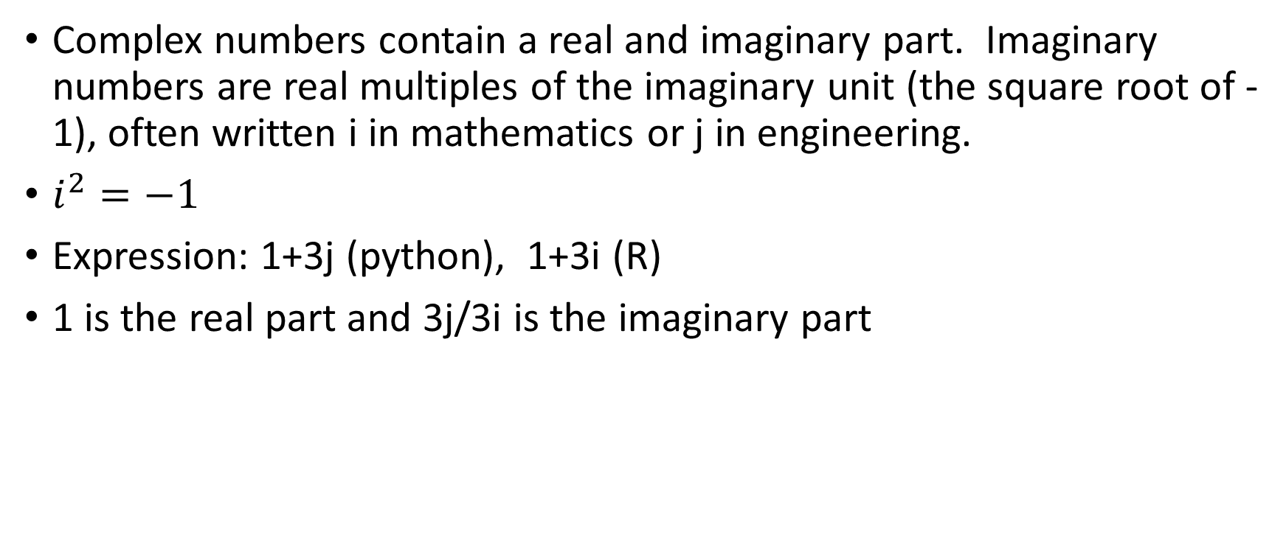
Complex type
Complex numbers contain a real and imaginary part. Imaginary numbers are real multiples of the imaginary unit (the square root of -1), often written i in mathematics or j in engineering.
$i^{2}=−1$
Expression: 1+3j (python), 1+3i (R)
1 is the real part and 3j/3i is the imaginary part

Slide 20
Complex type in R
> z = 1+2i
> class(z)
[1] “complex”
>sqrt(-1) #square root of -1
[1] NaN
> sqrt(-1+0i)
[1] 0+1i
> sqrt(as.complex(-1))
[1] 0+1i

Slide 21
Character types
Character types represent string values.
String values is different from previous types. In string values, we can include numeric numbers, letters, or special characters like ‘+’, ‘:’,… anything you can get from a keyboard.
Example character types
“aabbcc’aabbcc’_”
“1234 “
Please notice that there are spaces after ‘4’ on above string values.

Slide 22
Character in R
> x = as.character(3.14)
> x
> class(x)
[1] “character”
Two character values can be concatenated together.
> fname = “Joe”; lname = “Smith”
> paste(fname, lname)
[1] “Joe Smith”

Slide 23
Character in R
One important thing to notice is that the index of R starts from 1 rather than 0.
To extract a substring from a string. (get one consecutive part of this string)
> substr(“hello world”, start = 7, stop=11)
[1] “world”
Replace some substring in a string.
> sub(“world”, “data”, “hello world”)
[1] “hello data”

Slide 24
Data Types in R
Vectors
All elements must be the same type(mode)
Scalars
Treated as one-element vectors in R
Matrices
An array (rows and columns) of values
All values must be the same type(mode)
Arrays
Similar to matrices, but with more than two dimensions
Lists
Like a vector, but elements can be of different modes
Data frames
Like a matrix, but elements can be of different modes

Slide 25
Data frame
Data frame as a way to store data in rectangular grids that can easily be overviewed.
Each row of these grids corresponds to measurements or values of an instance, while each column is a vector containing data for a specific variable. This means that a data frame’s rows do not need to contain, but can contain, the same type of values: they can be numeric, character, logical, etc.

Slide 26
Code Examples

Slide 27
Plot in R
Haoyu Zhang

Slide 28
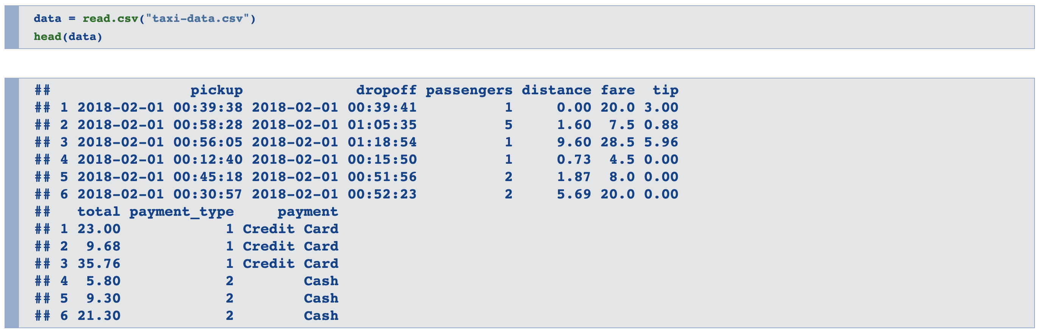
Take Taxi Data as an example
First, import Data

Slide 29
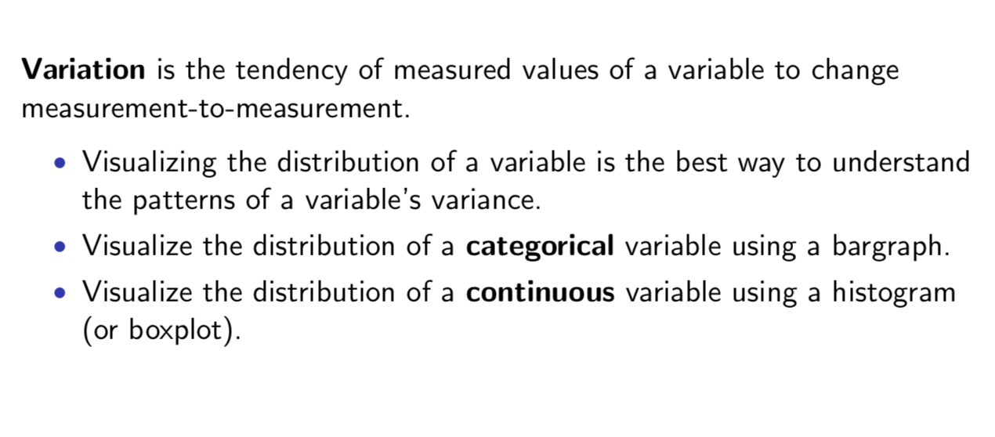

Slide 30
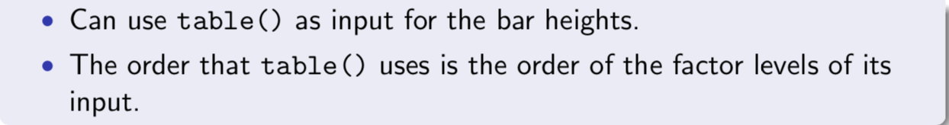
Bar Plot
Produce a bargraph using barplot(heights, labels) where heights is a vector of values for the heights of each bar and labels is an optional vector of labels for each bar.

Slide 31
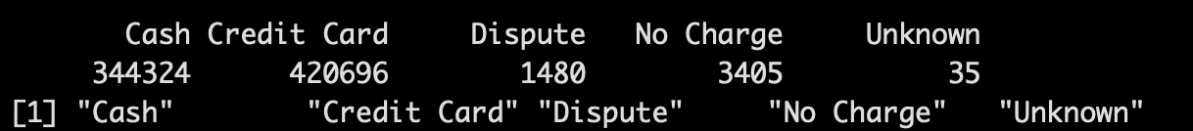
Produce a bargraph using barplot(heights, labels) where heights is a vector of values for the heights of each bar and labels is an optional vector of labels for each bar.
>table(data$payment)
>names(table(data$payment))
>levels(data$payment)

Slide 32
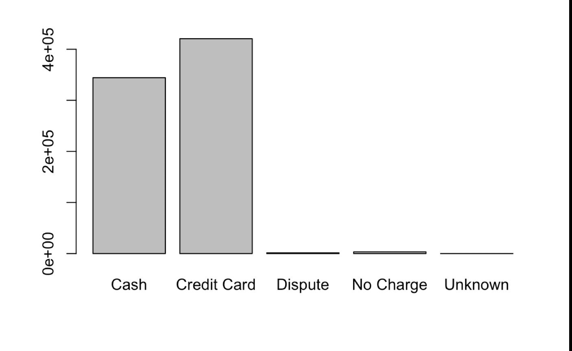
>barplot(height = table(data$payment), names.arg = >names(table(data$payment)))

Slide 33
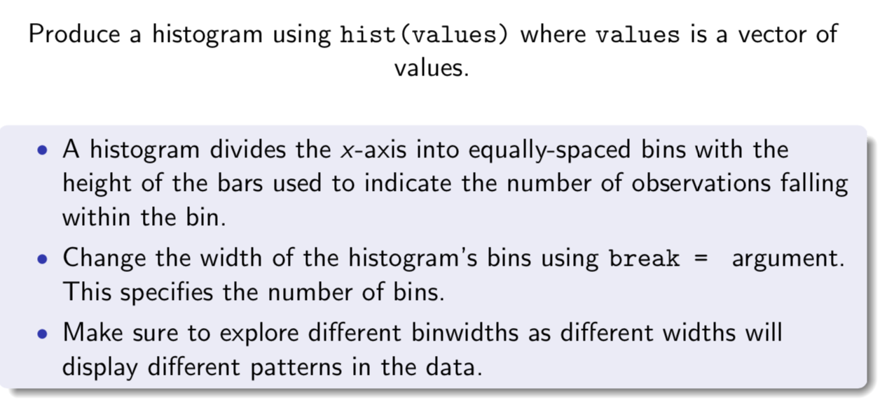
Histogram in R

Slide 34
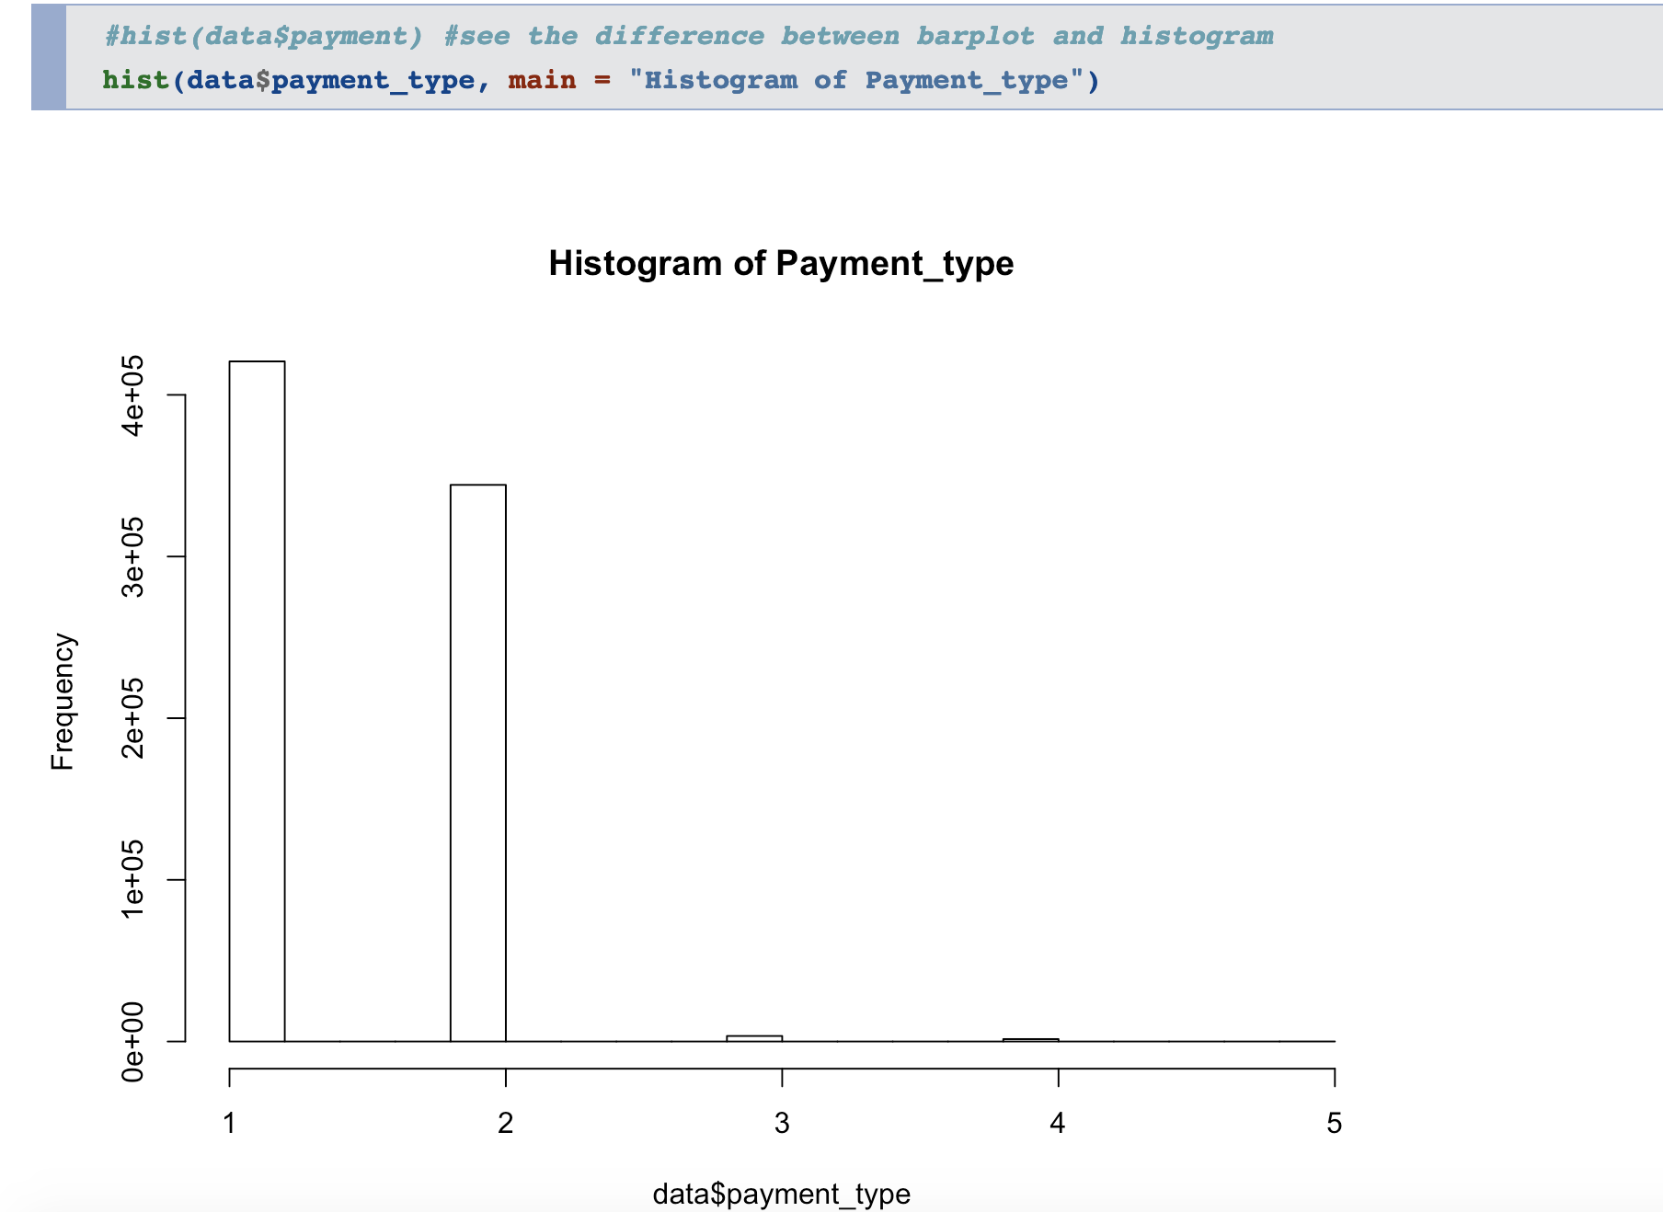

Slide 35
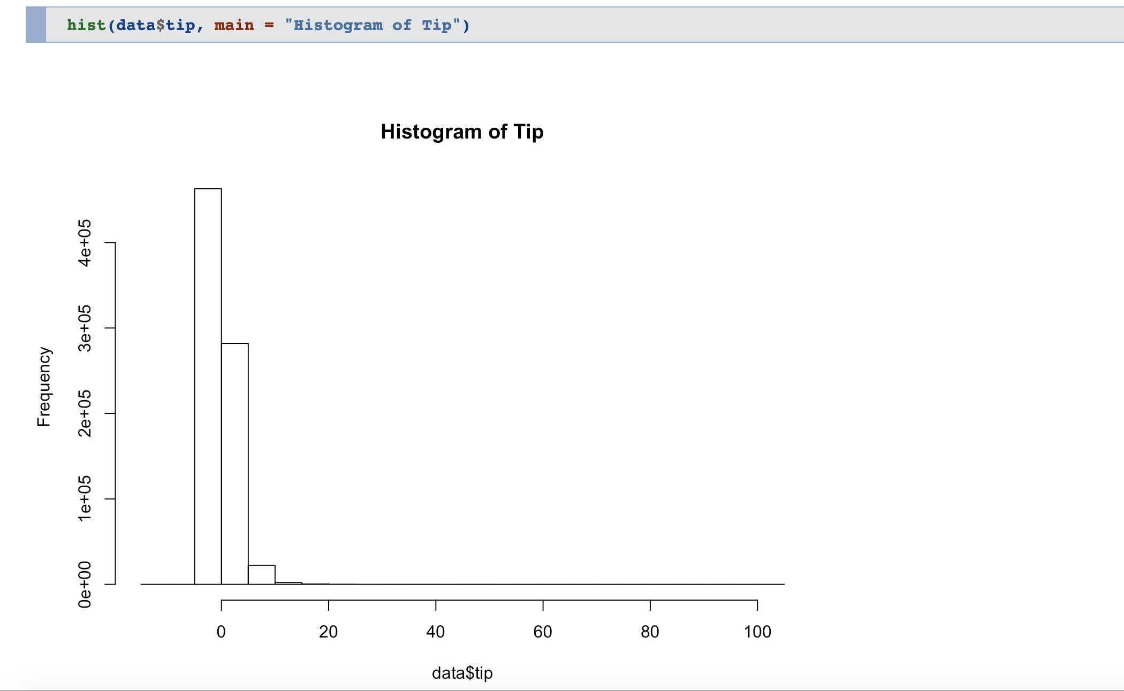

Slide 36
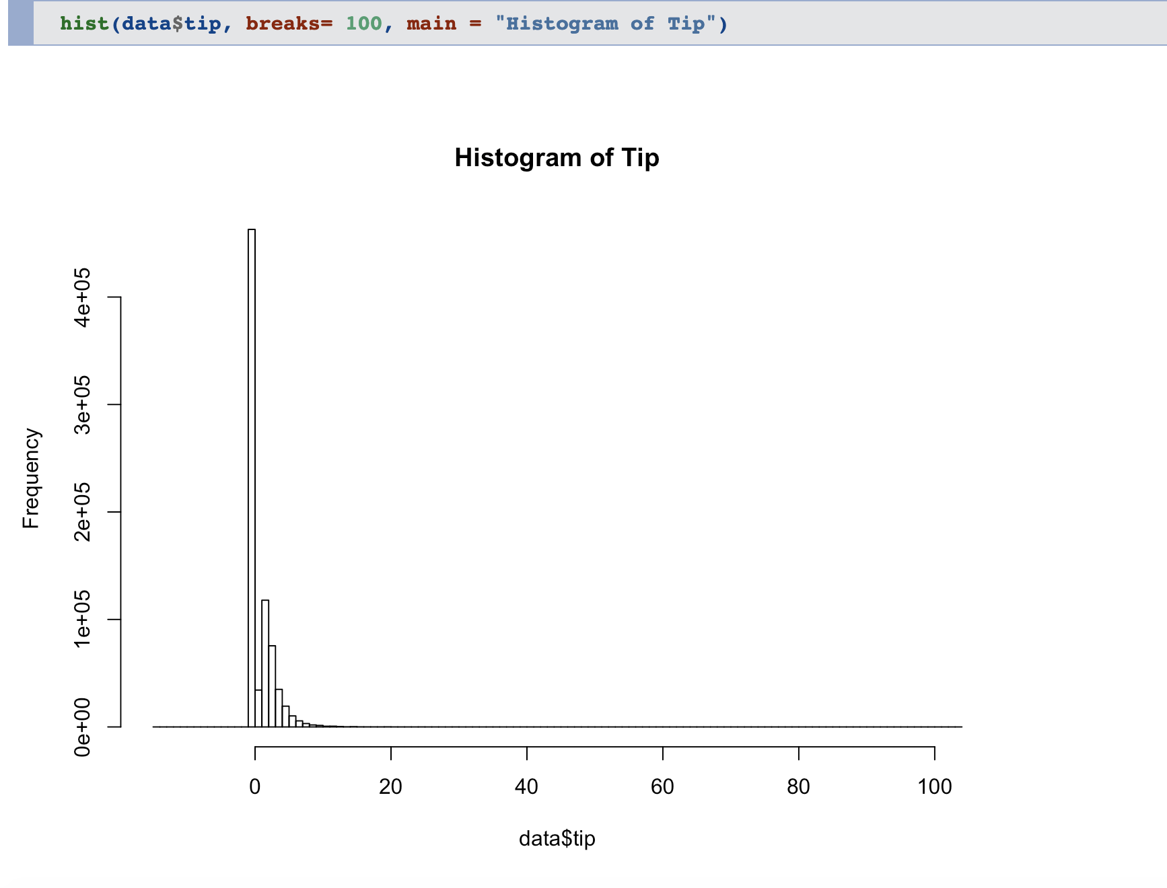

Slide 37
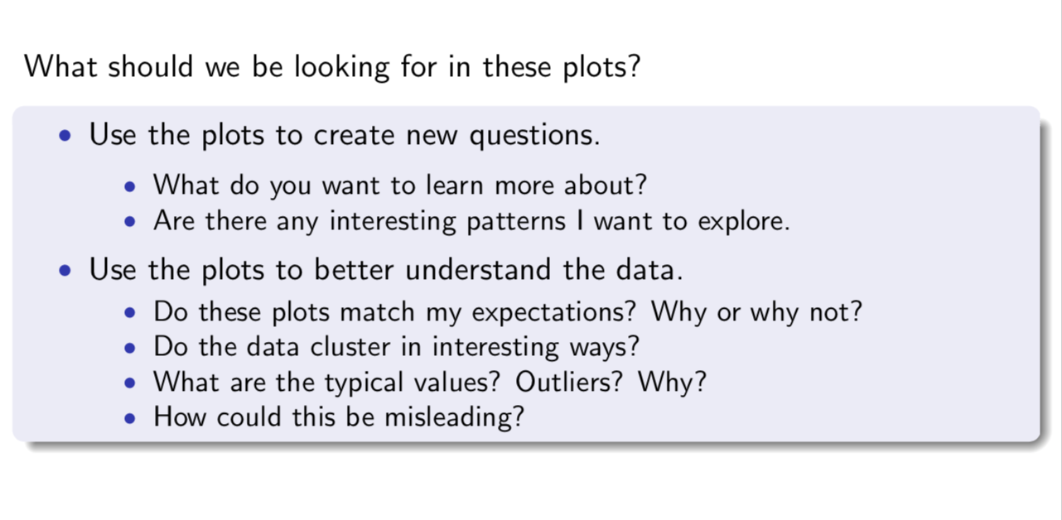

Slide 38
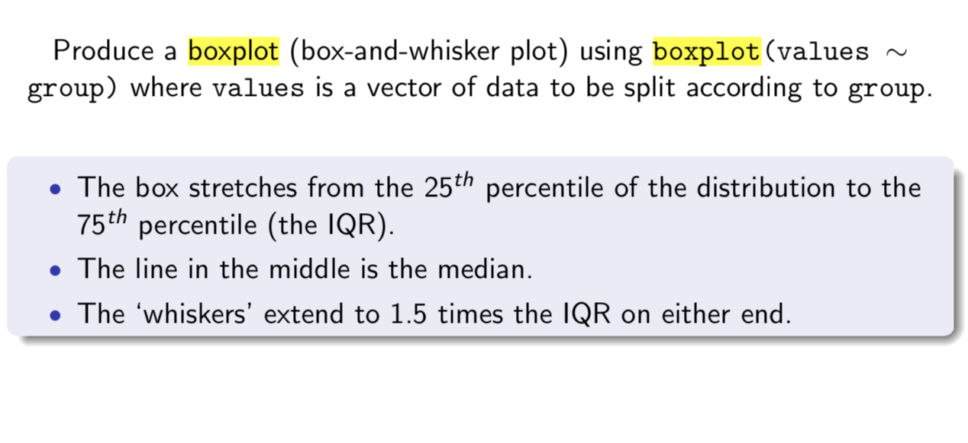
Boxplot in R

Slide 39
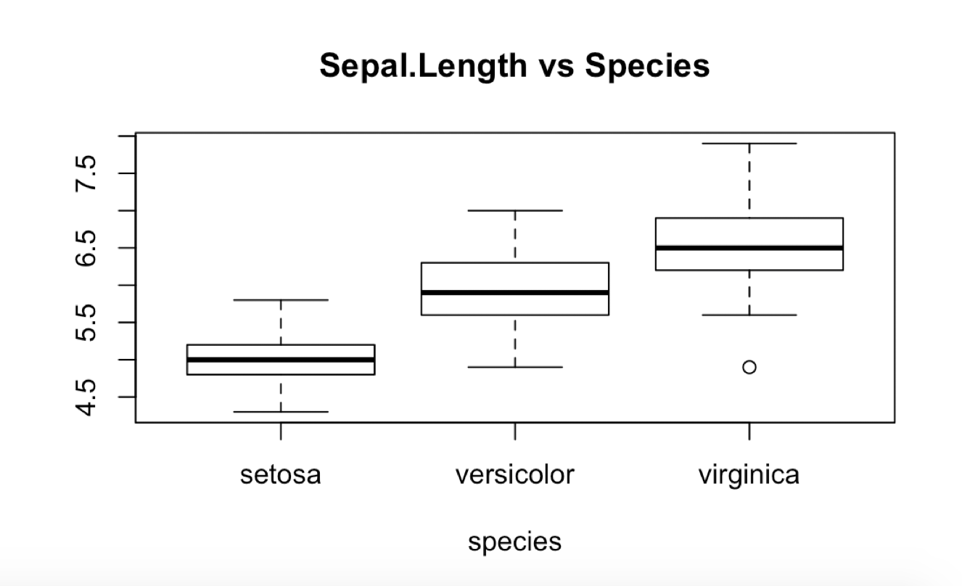
A quick Example in IRIS
>boxplot(Sepal.Length~Species, data = iris, xlab = "species")

Slide 40
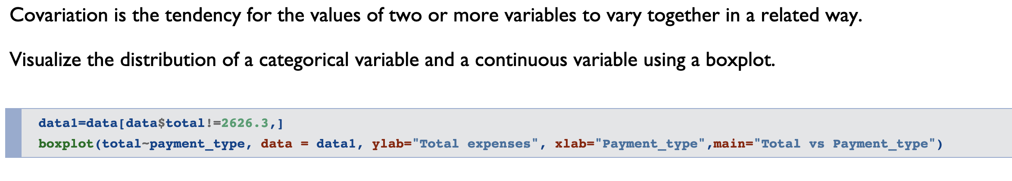

Slide 41
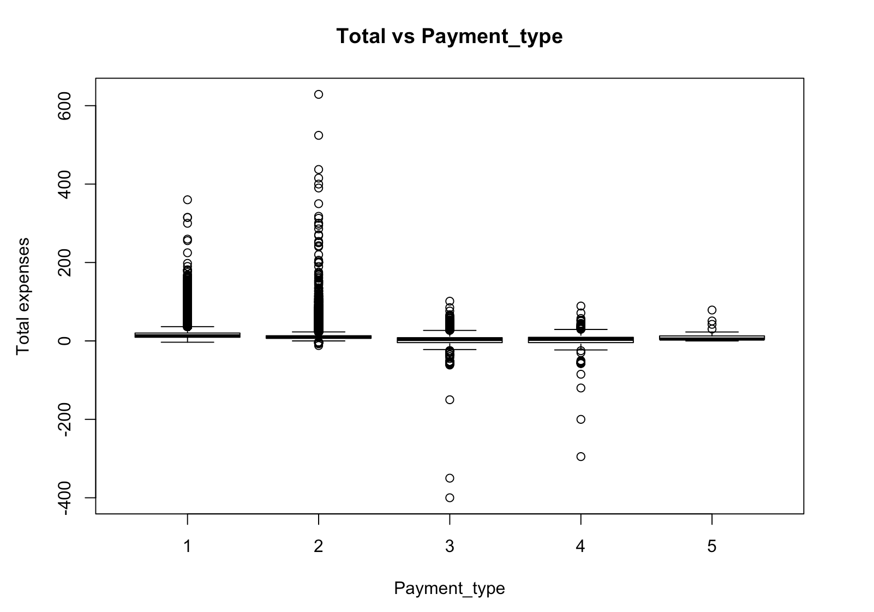

Slide 42
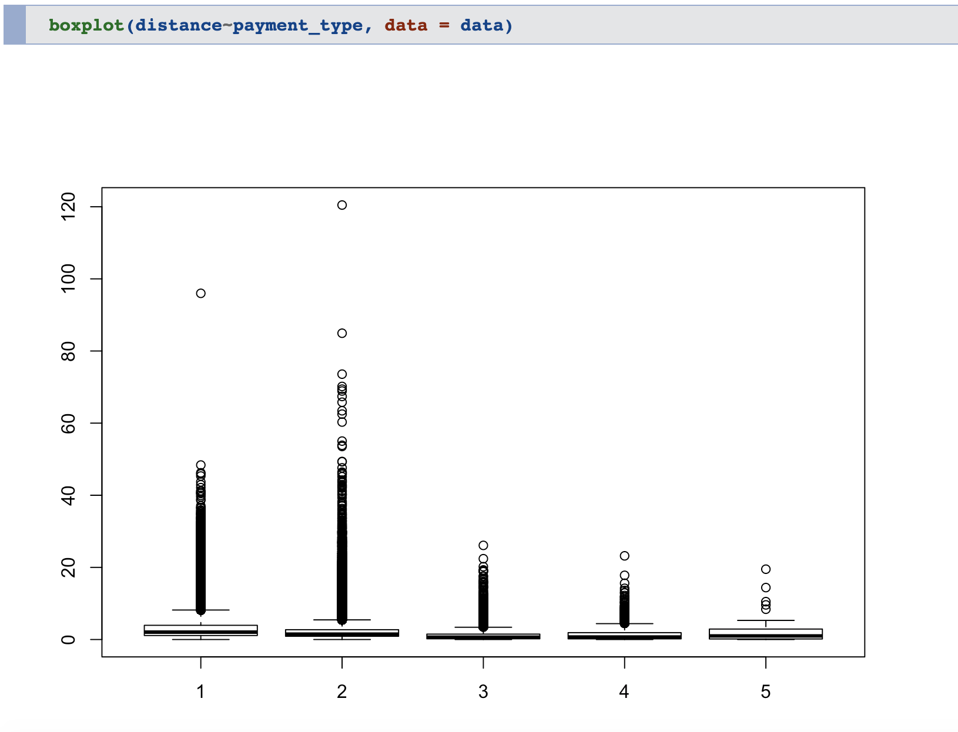

Slide 43
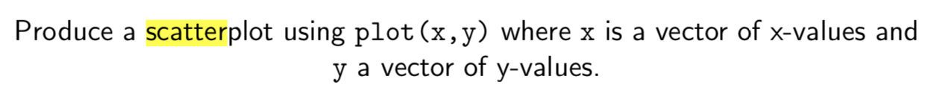
Scatter in R(Plot function)

Slide 44
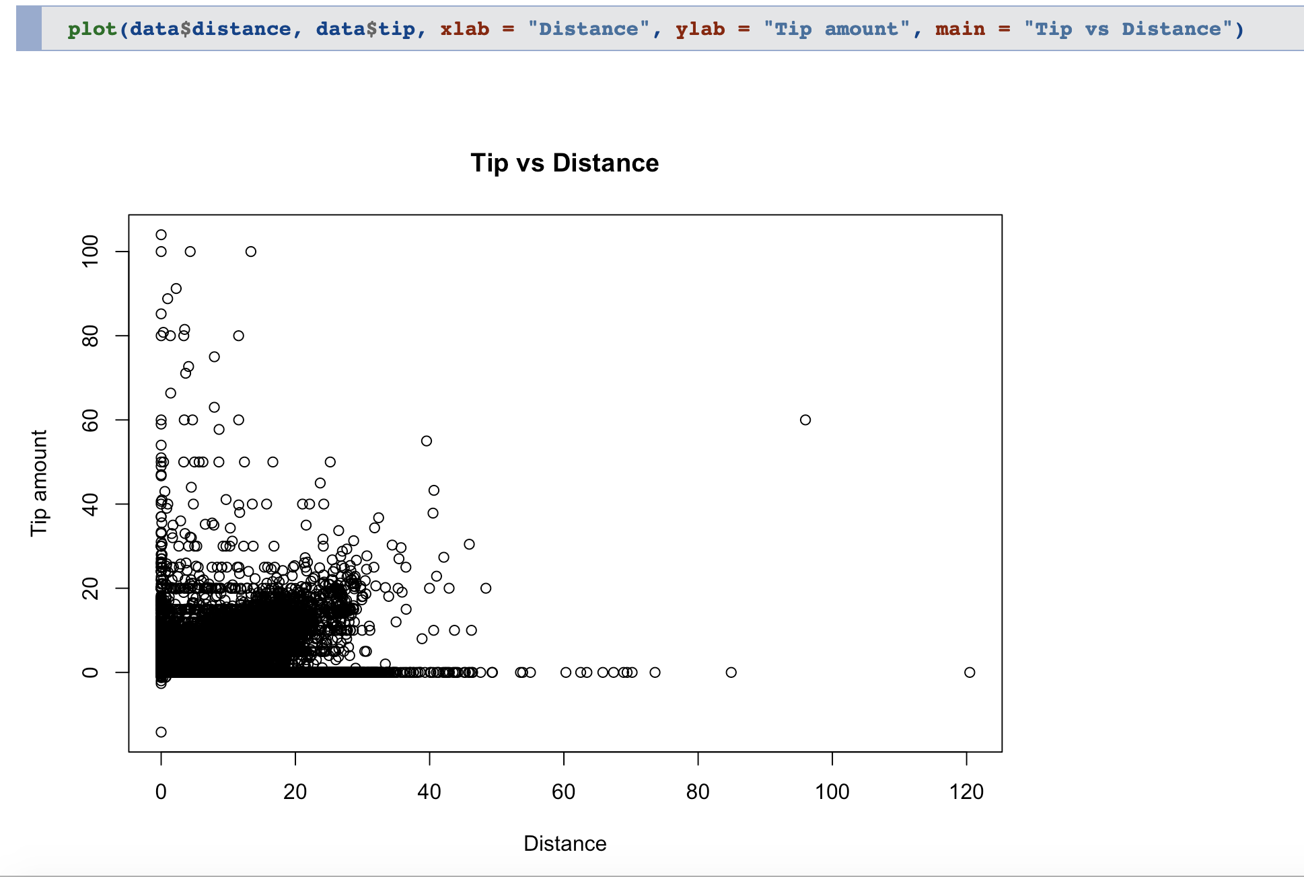

Slide 45
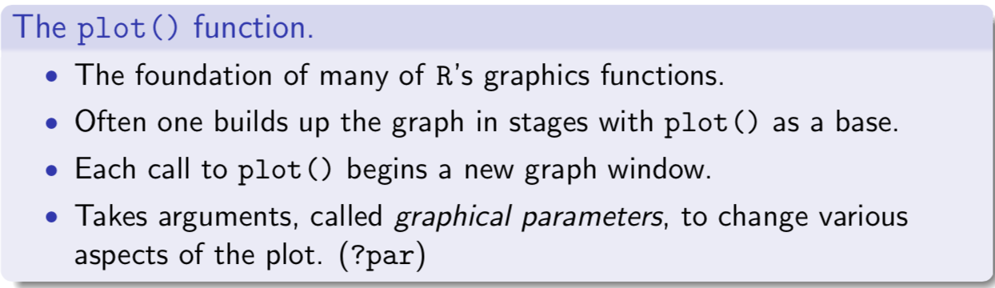

Slide 46
Next Step:
Make the plot grouped by payment method

Slide 48
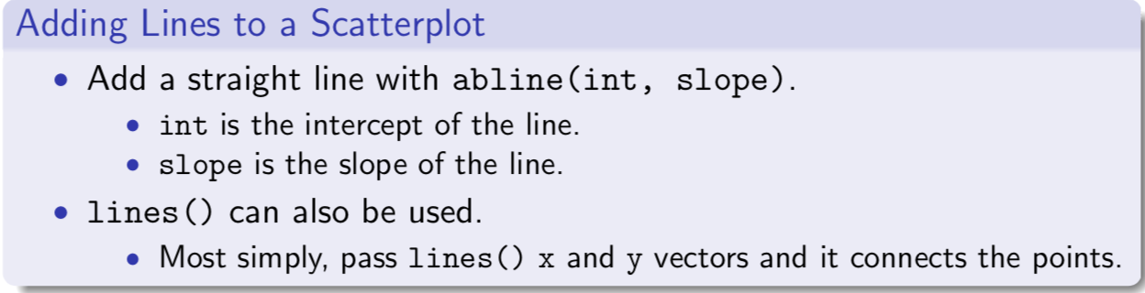
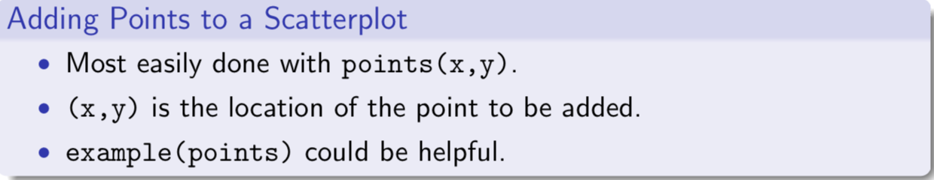

Slide 49
You can do much more with plot function
Explore More about plot() function by reading ?plot
Try to plot your own plot!

